Slide 1

GO FOR FOOD
GO-4-FOOD

Slide 2

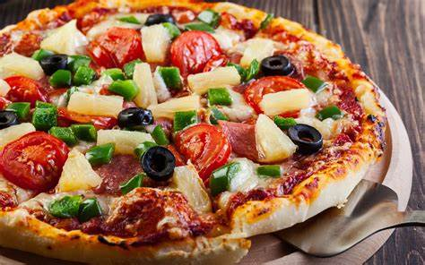
GO 4 FOOD

Slide 3
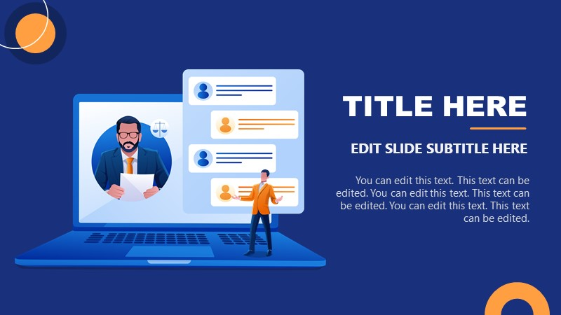
OBJECTIVE
The general objectives of the project are to develop a reliable, convenient and accurate Ordering System.
The general objectives of the project are to develop a reliable, convenient and accurate Ordering System

Slide 4
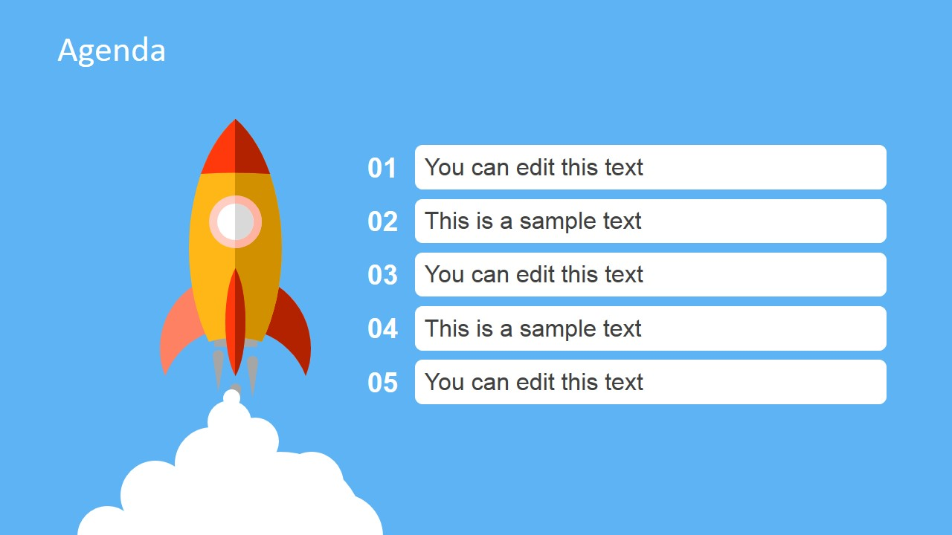
SCOPE
fastest-growing

Slide 5
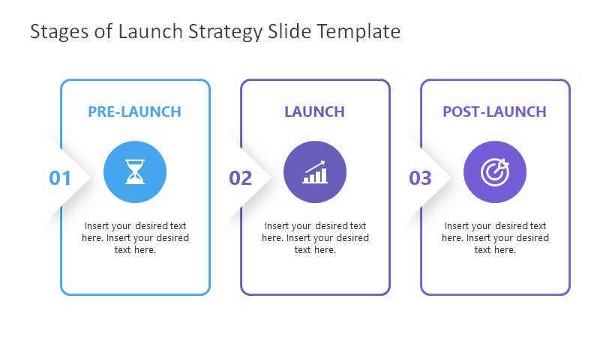
External Interface Requirement
User Interfaces
Hardware Interfaces
Software Interfaces
The user interface will be implemented using any android smartphone app browser.
There shall be logical address of the system in IPv6 format.
The system shall communicate with the Configurator to identify all the available components to configure the product

Slide 6
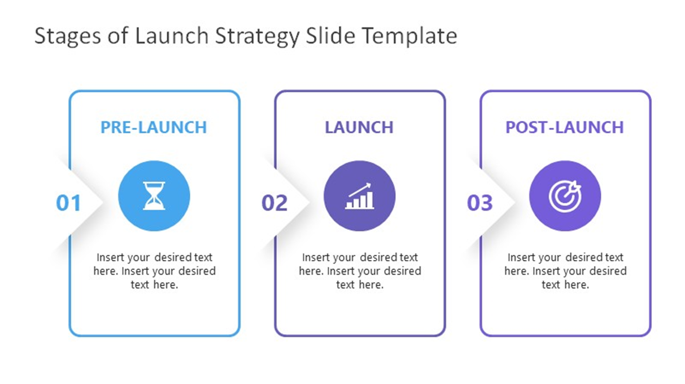
Comm. Interfaces
Hardware Interfaces

Slide 7

4.1 Performance Requirements
The product will be based on local server.
The product will take initial load time.
The performance will depend upon hardware components.
Payment system will be fully secure through POS system.
Different database for employee.
4.2 Safety and Security Requirements
The source code developed for this system shall be maintained in configuration management tool.
The whole system is secured. Only Admin can access all the data.
This system will use HTTPS. Because of this protocol this is more secure.
This system will use secured POS system.
5. Other Requirements
5.1 Licensing Requirements
Not Applicable
5.2 Legal, Copyright, and Other Notices
All right reserved by our team.
5.3 Applicable Standards
It should be as per the industry standard.

Slide 8
SOME GLIMPSE OF FRONT-END
Operating Environment
Operating System:
Minimum Windows 7. Better environment Windows 8, 8.1, 10.
Language: Java
It is need to use web application to place food order in this system.
Whole system should be covered by Wi-Fi connection.

Slide 9
Go 4 Food want their customers to make their life easy by serving them delicious food in just few clicks.

Slide 10
The PPT is divided into three parts
Front-End
Back-End
General Output

Slide 11
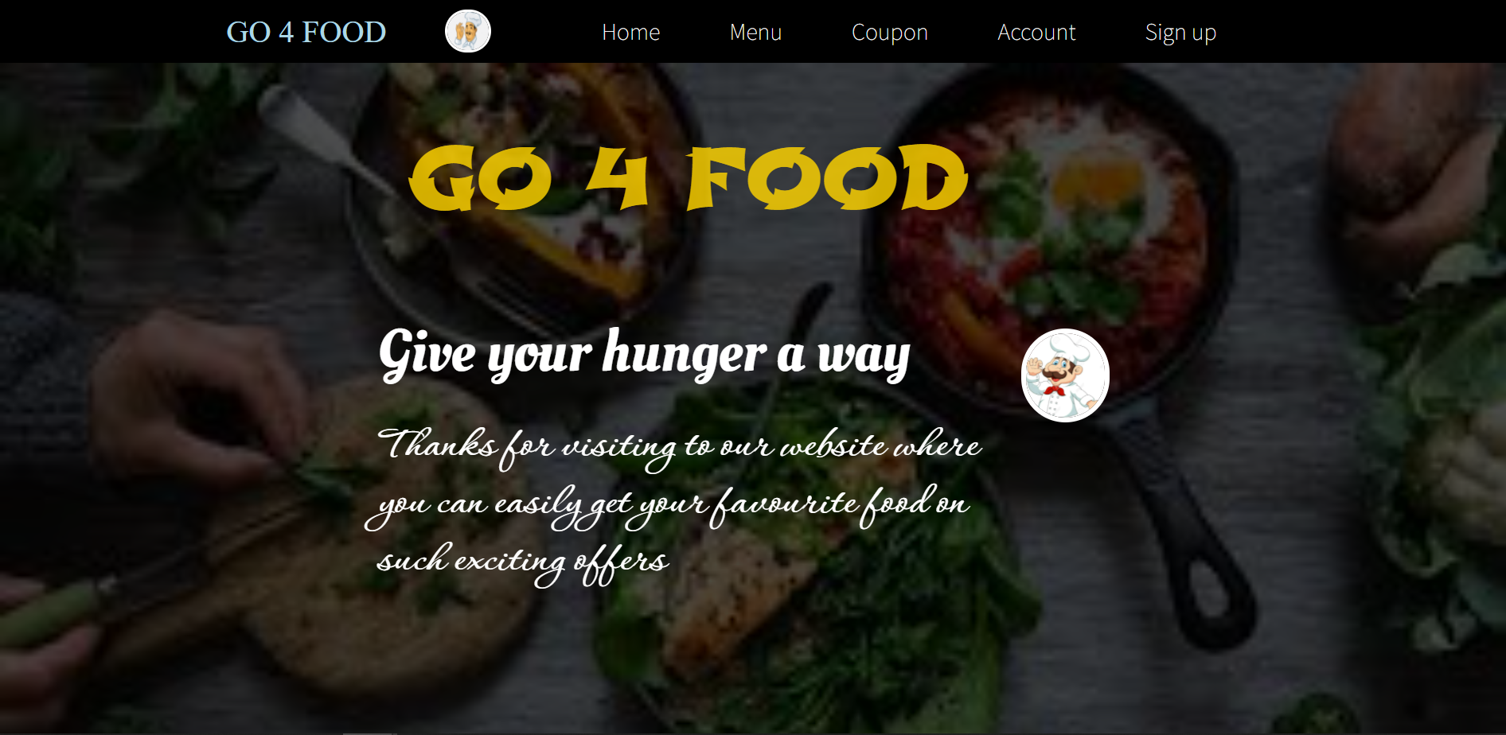

Slide 12
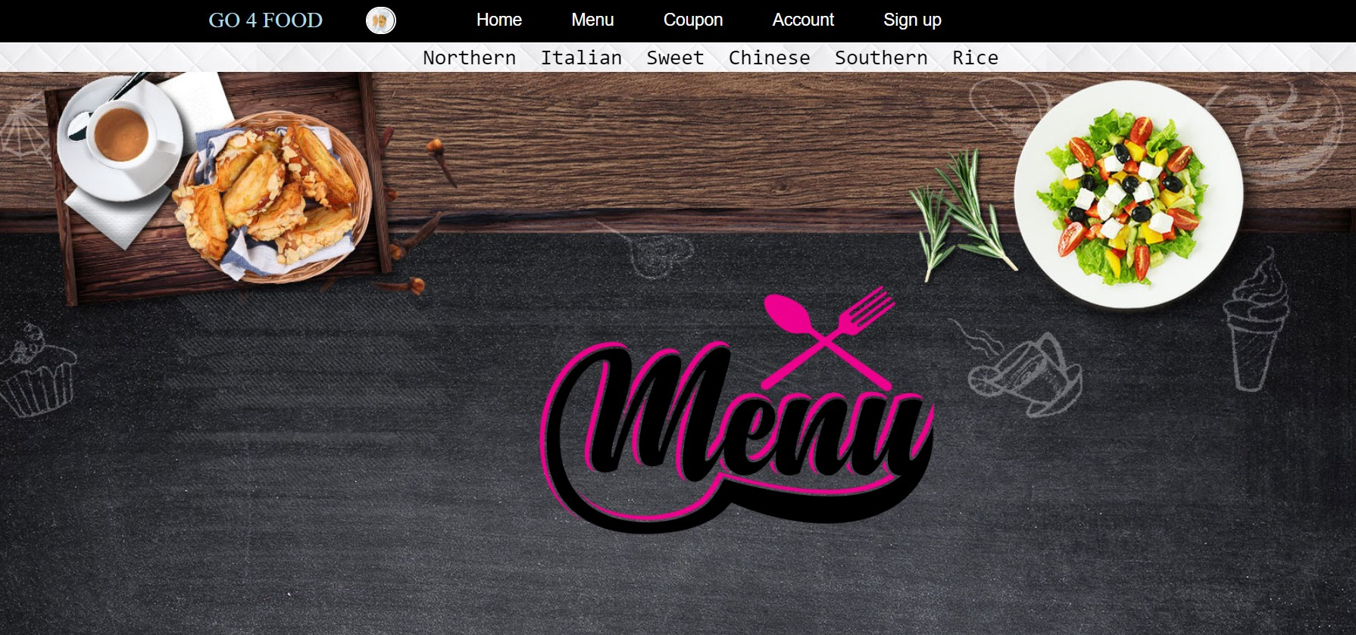

Slide 13
SOME GLIMPSE OF BACK-END

Slide 14
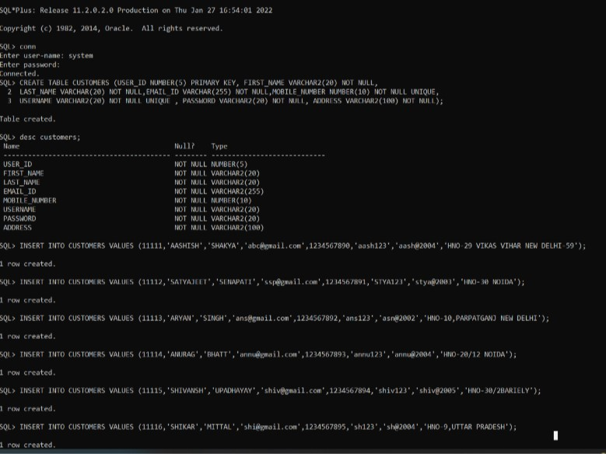

Slide 15
